Slide 1
ALPHANUMERIC PUZZLES
By:-
Naveen Kumar Jain
(Aptitude Trainer)

Slide 2
ALPHANUMERIC PUZZLES
Y W @ 1 & C N 3 P L B 9 ↑ = D * E 2 £ M V ß 7 # 4 F G 5
If the numbers immediately preceding the symbols are attached to the value double their numerical value, then what will be the sum of the values of all sum numbers?
A) 22 B) 26 C) 36 D) 38
Ans: Option D
x
(1
+2
+7)
= 2
+9
Required sum
=2 x 19
=38

Slide 3
ALPHANUMERIC PUZZLES
2 * 8 5 6 B 9 ß Q 3 E 1 7 R D 4 £ (13) U @ K (18) A (14) P
If each alphabet has a value of zero, each symbol has a value equivalent to the square of the numeral that immediately precedes the symbol or the value of 1 if it is not immediately preceded by any numeral, what will be the sum of the values of the first 10 elements of the series starting from the left end?
A) 46 B) 79 C) 107 D) 118
Ans: Option D
The values of the first 10 elements from the left end may be shown as under
(2) (2²) (8) (5) (6) (0) (9) (9²) (0) (3)
Required sum =
2+4+8+5+6+9+81+3
=118

Slide 4
ALPHANUMERIC PUZZLES
M 1 E ß R B 3 A K 7 £ # 9 ß U D I N 4 6 % F H 2 @ 8 W
What should come in place of the question mark in the following series based on the above arrangement?
E B M A £ B 9 D £ ? H 8 %
A) N % D B) N F D C) 4 F D D) I 6 D
Ans: Option A
Each element of each term moves 5 steps forward to give the corresponding element of the next term

Slide 5
ALPHANUMERIC PUZZLES
S K 6 £ Q 2 R * C F 8 E ß G 2 # 4 9 L N 3 U V 5 Y α B 7 W 9
S K £, is related to 9 W B in the same way as Q 2 * is related to
A) a V U B) a Y 5 C) 7 B Y D) B Y V E) a Y V
Ans: Option E
In each pair, the corresponding elements of both the terms occupy the same position from the beginning and end of the given sequence.

Slide 6
ALPHANUMERIC PUZZLES
↑ 9 B Q = ß 2 5 R J δ L 3 @ Y M E 6 8 * ÷ D F 4 ß H 7 ©
How many such numbers are there in the arrangement each of which is immediately preceded by a symbol but not immediately followed by a letter? A) Nil B) One C) Two D) Three
Ans: Option B
↑ 9 B Q = ß 2 5 R J δ L 3 @ Y M E 6 8 * ÷ D F 4 ß H 7 ©
ß 2 5

Slide 7
ALPHANUMERIC PUZZLES
A B 7 C D 9 Z Y * P 2 M © K S 3 ↑ 5 N T @
How many such digits are there in the sequence each of which is immediately preceded as well as followed by a letter?
A) Nil B) One C) Two D) Three
Ans: Option D
A B 7 C D 9 Z Y * P 2 M © K S 3 ↑ 5 N T @
B 7 C
D 9 Z
P 2 M

Slide 8
ALPHANUMERIC PUZZLES
W 1 R % 4 J E # 7 M T 2 I 9 B H 3 A φ 9 F Q 5 D G 6 U S P
Which of the following is the seventh to the right of the eighteenth from the right end?
A) A B) E C) f D) #
Ans: Option C
The 18th element from the right end of the arrangement is 2, and the 7th'element to the right of 2 is φ

Slide 9
ALPHANUMERIC PUZZLES
J Y 2 = S £ ξ E G M œ 7 € H P 9 K L ß ¢ W Q 1 3 # C D ©
2 Y S is to E G £ in the same way as P H K is to?
A) W Q ß B) @ W L C) @ ß Q D) @ W K
Ans: Option B
In each pair, the first, second and third elements of the first term move 5, 7 and 1 steps forward respectively to give the corresponding elements of the second term.

Slide 10
ALPHANUMERIC PUZZLES
Study the following arrangement carefully and answer the questions given below :
R E 5 D A P & 3 T I Q 7 9 B # 2 K % U 1 M W 4 * J 8 N
How many such numbers are there in the above arrangement, each of which is immediately preceded by a consonant and not immediately followed by a consonant?
A) None B) One C) Two D) Three
Ans: Option C
R E 5 D A P & 3 T I Q 7 9 B # 2 K % U 1 M W 4 * J 8 N
Q 7 9
W 4 *

Slide 11
ALPHANUMERIC PUZZLES
W 5 R 1 & * F R ? G 2 4 L % K * A $ Y
Remove all symbols from the sequence. What is the 6th component present when counted from the right-hand side of the line?
A) R B) Y C) 2 D) K
Ans: Option C
W 5 R 1 & * F R ? G 2 4 L % K * A $ Y
W 5 R 1 & F R G 2 4 L K A Y
2

Slide 12
ALPHANUMERIC PUZZLES
W 5 R 1 & * F R ? G 2 4 L % K * A $ Y
Mention the number of symbols present in the sequence between the 1st vowel starting from the left and the 1st consonant starting from the right-hand side of the sequence?
A) One B) Two C) Three D) Four
Ans: Option A
W 5 R 1 & * F R ? G 2 4 L % K * A $ Y
A $ Y

Slide 13
PUZZLES
By:-
Naveen Kumar Jain
(Aptitude Trainer)

Slide 14
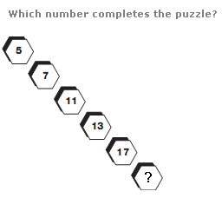
NUMBER PUZZLES
As you move diagonally down, numbers follow the sequence of Prime Numbers.
Ans 19

Slide 15
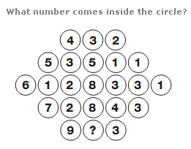
NUMBER PUZZLES
Looking at the diagram in rows, the central circle equals half the sum of the numbers in the other circles to the left and right of the centre.
Ans 6

Slide 16
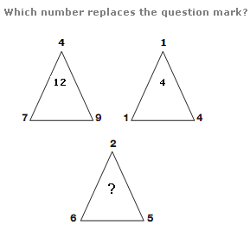
NUMBER PUZZLES
The number at the centre of each triangle equals the sum of the lower two numbers minus the top number.
Ans 9

Slide 17
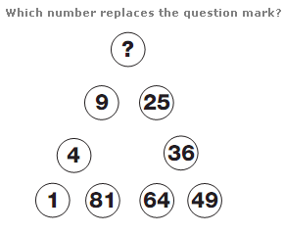
NUMBER PUZZLES
Starting bottom left and moving clockwise around the triangle, numbers follow the sequence of Square Numbers.
Ans 16

Slide 18
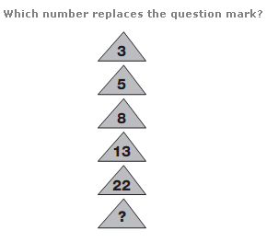
NUMBER PUZZLES
Working from top to bottom, double each number and subtract 1, then 2, then 3 etc.
Ans 39

Slide 19
NUMBER PUZZLES
Working from top to bottom, double each number and subtract 1, then 2, then 3 etc.
Ans 39

Slide 20

NUMBER PUZZLES
Moving from left to right, numbers increase by 2,3,4 and 5.
Ans: 40

Slide 21
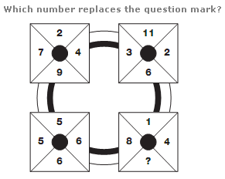
NUMBER PUZZLES
In each square of the diagram, the sum of the numbers is always 22.
Ans: 9

Slide 22
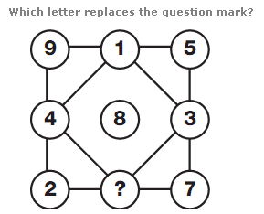
NUMBER PUZZLES
The numbers in each row and column add up to 15.
Ans 6

Slide 23
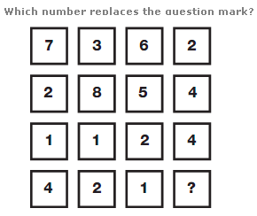
NUMBER PUZZLES
Working in columns, the sum of the numbers in each column is always 14.
Ans 4

Slide 24
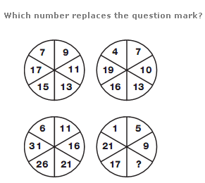
NUMBER PUZZLES
In each circle, starting at the top left segment, numbers increase, as you move clockwise, by 2 for the upper left circle, 3 for the upper right, 4 for the lower right and 5 for the lower left.
Ans 13

Slide 25
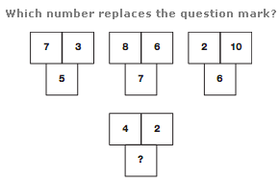
NUMBER PUZZLES
In each group of 3 numbers, the lower number equals the average of the top two numbers.
Ans 3

Slide 26
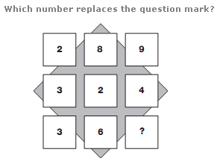
NUMBER PUZZLES
Reading each row as a 3 digit number, the rows follow the sequence of square numbers, from 17 to 19.
Ans 1

Slide 27
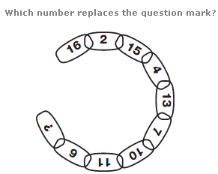
NUMBER PUZZLES
Moving clockwise, around alternate segments in the chain, one sequence decreases by 1, 2, 3 and 4 each time, while the other increases by 2, 3, 4 and 5.
Ans 16

Slide 28
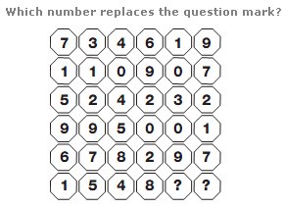
NUMBER PUZZLES
Reading each row as 3 separate 2-digit numbers, the central number equals the average of the left and right hand numbers.
Ans 8,1

Slide 29
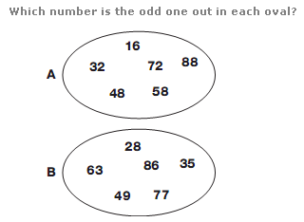
NUMBER PUZZLES
In the first oval, all numbers are multiples of 8, and in the second, they are all multiples of 7.
Ans A.58
Ans B.86

Slide 30
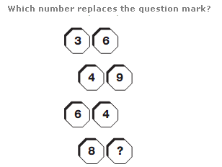
NUMBER PUZZLES
Reading each pair of numbers as a 2 digit number, they follow the sequence of square numbers from 6 to 9.
Ans 1

Slide 31
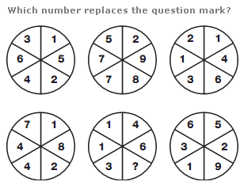
NUMBER PUZZLES
Taking the top row of circles, numbers in the central circle equal the sum of the numbers in corresponding segments of the left and right hand circles. In the bottom row, numbers in the central circle equal the difference between numbers in corresponding segments of the left and right hand circles.
Ans 7

Slide 32
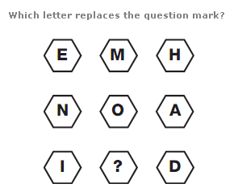
MISSING LETTERS PUZZLES
Working in rows, add together the numerical values of the left and right hand letters to give the numerical value of the central letter.
Ans M

Slide 33
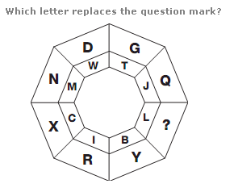
MISSING LETTERS PUZZLES
In each segment of the diagram are a pair of letters, one of which is the same distance from the start of the alphabet as the other is from the end.
Ans O

Slide 34
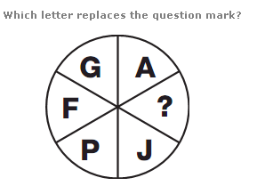
MISSING LETTERS PUZZLES
The numerical values of the letters in opposite segments of the circle always add up to 17.
Ans K

Slide 35
MISSING LETTERS PUZZLES
The numerical values of the letters in opposite segments of the circle always add up to 17.
Ans K

Slide 36

MISSING LETTERS PUZZLES
As you move down, the numerical value of the letters follows the sequence of Prime Numbers.
Ans K

Slide 37
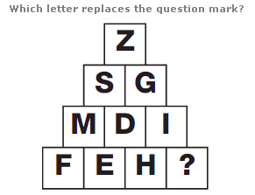
MISSING LETTERS PUZZLES
The numerical values of the letters in each row add up to 26 each time.
Ans G

Slide 38
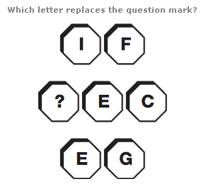
MISSING LETTERS PUZZLES
Writing each letter as its numerical value and working in rows, add the top 2 digit number to the bottom 2 digit number to give the 3 digit result in the centre.
Ans A

Slide 39
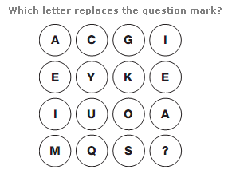
MISSING LETTERS PUZZLES
Starting at the top left and moving down, then right one column and up etc in a snakes and ladders pattern, letters move through the alphabet 4 letters at a time.
Ans W

Slide 40
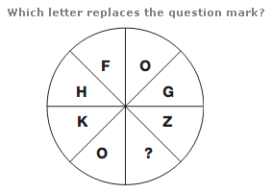
MISSING LETTERS PUZZLES
Starting at F and moving anti-clockwise, letters move through the alphabet in steps of 2, 3, 4, 5 etc.
Ans T

Slide 41
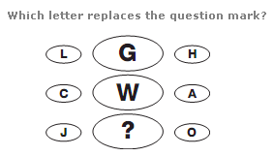
MISSING LETTERS PUZZLES
In each row, add the numerical value of the left and right hand letters together and write the letter with the reverse alphabetical value in the centre.
Ans B

Slide 42
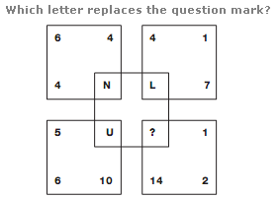
LOGICAL PUZZELS
Adding the three numbers in each square together gives the numerical value of the letter at the centre of each square.
Ans Q

Slide 43
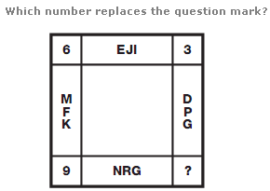
LOGICAL PUZZELS
The value at each corner of the diagram equals the difference between the sums of the numerical values of the letters in the boxes adjacent to the corner.
Ans 12

Slide 44
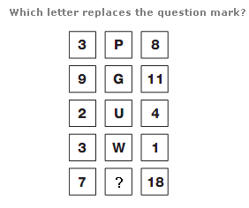
LOGICAL PUZZELS
In each row of the diagram, the reverse alphabetical value of the central letter equals the sum of the left and right hand digits.
Ans B

Slide 45
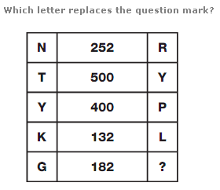
LOGICAL PUZZELS
In each row, multiply the numerical values of the left and right hand letters, putting the result in the centre.
Ans Z

Slide 46
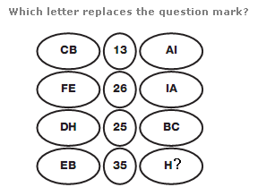
LOGICAL PUZZELS
Convert each letter to its numerical value, and read each pair of values as 2 digit numbers. In each row, the number in the centre equals the difference between the 2 digit values on the left and right.
Ans G

Slide 47
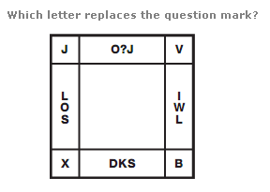
LOGICAL PUZZELS
Start in the top left hand corner and move anti clockwise around the perimeter of the square. Letters are written in alphabetical order, skipping 1 letter, then 2 letters, then 3 etc.
Ans Y

Slide 48
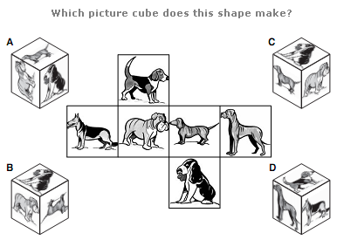
LOGICAL PUZZELS
Ans A

Slide 49
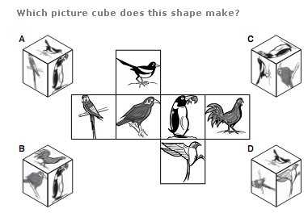
LOGICAL PUZZELS
Ans C

Slide 50
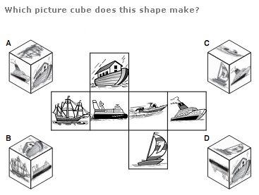
LOGICAL PUZZELS
Ans B

Slide 51
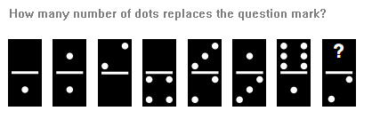
LOGICAL PUZZELS
Starting on the left and working to the right, take pairs of dominoes and calculate the sum of the dots they are displaying. This sum follows the sequence 3, 6, 9 and 12.
Ans 3

Slide 52
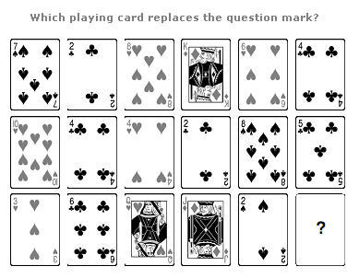
PLAYING CARD PUZZELS
Taking red cards as positive values and black cards as negative values, in each column of the diagram, the lower card value equals the sum of the two upper card values. The suits are used alternately in each column.
Ans 9 of club

Slide 53
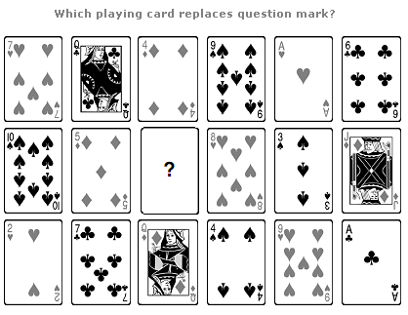
PLAYING CARD PUZZELS
Start at the top left of the diagram and move to the right, then down one row and to the left etc. in a snakes and ladders pattern. The value of each card increases by 5 each time, with their suit following the sequence of hearts, clubs, diamonds and spades
Ans King of club

Slide 54
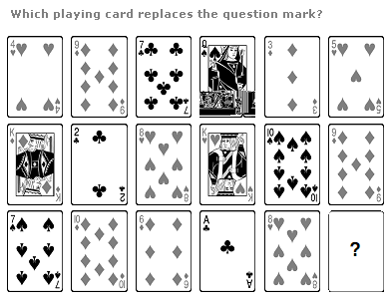
PLAYING CARD PUZZELS
Taking the value of Aces as 1 and all court cards as 10, In each column of the diagram, the value of the sum of the 3 cards is always 21.
Ans 7 (Any suit)

Slide 55
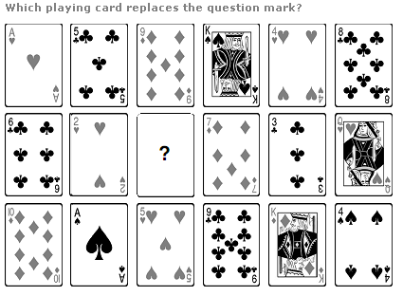
PLAYING CARD PUZZELS
There are 2 sequences in the grid - one determining the value of the card, and
one determining the suit of the card. Starting on the top left and moving right, then down one row and to the left, then down the final row and to the right, cards are arranged in order, with their value increasing by 4 each time.
To calculate the suit of each card, start on the top left and move down, then right one row and move up etc. cards are arranged in the order Hearts, Clubs, Diamonds, Spades.
Ans Jack of Spade

Slide 56
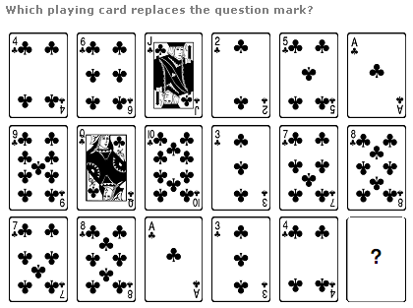
PLAYING CARD PUZZELS
In each column of the diagram, add the top and bottom card values together and subtract 2 to give the value of the central card.
Ans 9 of club

Slide 57
Seating Arrangement
By:-
Naveen Kumar Jain
(Aptitude Trainer)

Slide 58
BASIC CONCEPT
Seating Arrangement is a process of making a group of people sit as per a prefixed manner.
Questions based on seating arrangement reasoning involve arranging the persons or objects according to the conditions given in the question.
Questions are based on the seating sequence pattern, direction, facing outside or inside, etc
Given information may be in jumbled form.
Candidates have to segregate this information and make the arrangement as per the given conditions.

Slide 59
Types of Seating Arrangement
1. Linear Seating Arrangement
2. Circular Seating Arrangement
3. Polygonal Arrangement

Slide 60
1. Linear Seating Arrangement
In this type, candidates are required to arrange people in a row or multiple rows according to the given conditions.
There are three types of Linear Seating Arrangement
(a) Single Row Unidirectional:
In these type of linear seating arrangement questions, people will be arranged in a single row and everyone will face in the same direction.
(b) Single Row Bidirectional:
In these type of linear seating arrangement questions, people will be arranged in a single row and they will face in two different directions.
(c) Dual Row:
In these type of linear seating arrangement questions, people will be arranged in 2 different rows.

Slide 61
1. Linear Seating Arrangement
Nine persons A, B, C, D, E, F, G, H, I are watching a movie in a theatre sitting in a row facing North. B is at one end of the row. H is seated adjacent to both F and G. C is to the immediate right of D and at the third place to the right of E. A is immediate left of F. F is at the third place to the left of B. Find out: Q: Who is at the end of the row? Q: What is the position of F with respect to D?
Nine persons
B is at one end of the row.
H is seated adjacent to both
F and G
C is to the immediate right of D and at the third place to the right of
A is immediate left of F
F is at the third place to the left of B
E is at the end of the row along with B
Position of F with respect to D is third to the right of D.
E
I
D
C
A
F
H
G
B

Slide 62
1. Linear Seating Arrangement
A, B and C are three boys while R, S and T are three girls. They are sitting such that the boys are facing the girls.
A and R are diagonally opposite to each other.
C is not sitting at any of the ends.
T is left to R but opposite to C.
(A). Who is sitting opposite to B ?
(B). Who is sitting diagonally opposite to B ?
A and R are diagonally opposite to each other.
C is not sitting at any of the ends.
T is left to R but opposite to C
boys
A
C
B
(A). Hence, R is sitting opposite to B.
(B). Hence, S is sitting diagonally opposite to B.
girls
S
T
R

Slide 63
2. Circular Seating Arrangement
In this type of questions, people will be seated around a circular table.
(a) Circular Unidirectional: In these type of circular seating arrangement questions, candidates are required to arrange people around a circular table, and everyone will face in the same direction such as either inside or outside.
(b) Circular Bidirectional: In these type of circular seating arrangement questions, candidates are required to arrange people around a circular table, and everyone will face in the same direction such as either inside or outside.

Slide 64
2. Circular Seating Arrangement
1. 6 Boys are sitting in a circle and facing towards the centre of the circle.
2. Rajeev is sitting to the right of mohan but he is not just at the left of Vijay.
3. Suresh is between Babu and Vijay.
4. Ajay is sitting to the left of Vijay.
Who is sitting to the left of Mohan ?
Rajeev is sitting to the right of mohan
Suresh is between Babu and Vijay
Ajay is sitting to the left of Vijay.
Suresh
Babu
Vijay
mohan
Ajay
Hence, Babu is sitting to the left of Mohan.
Rajeev

Slide 65
2. Circular Seating Arrangement
P, Q, R, S, T, U, V and W are sitting round the circle and are facing the centre.
P is second to the right of T who is the neighbour of R and V.
S is not the neighbour of P.
V is the neighbour of U.
Q is not between S and W. W is not between U and S.
1.Which two of the following are not neighbours ?
A. RV B. UV C. RP D. QW
2.Which one is immediate right to the V ?
A.P B. U C. R D.T
3.Which of the following is correct ?
A. P is to the immediate right of Q B. R is between U and V
C. Q is to the immediate left of W D. U is between W and S

Slide 66
2. Circular Seating Arrangement
P, Q, R, S, T, U, V and W are sitting round the circle and are facing the centre.
P is second to the right of T who is the neighbour of R and V.
S is not the neighbour of P.
V is the neighbour of U.
Q is not between S and W. W is not between U and S.
P is second to the right of T who is the neighbour of R and V.
V is the neighbour of U
U
1.Which two of the following are not neighbours ?
A. RV B. UV C. RP D. QW
V
S
Answer A. RV
2.Which one is immediate right to the V ?
A.P B. U C. R D.T
T
W
Answer D. T
3.Which of the following is correct ?
A. P is to the immediate right of Q B. R is between U and V
C. Q is to the immediate left of W D. U is between W and S
Q
R
P
Answer C.

Slide 67
3. POLYGONAL Seating Arrangement
A polygon is a closed figure formed with three or more sides. In these type of sitting arrangement reasoning questions, people will be seated around different shapes of table such as triangle, square, rectangle, pentagonal, hexagonal, octagonal, etc.
(a) Square Arrangement: In these types of polygonal seating arrangement questions, candidates are required to arrange people around a square table.
(b)Triangular Arrangement: In these types of polygonal seating arrangement questions, candidates are required to arrange people around a triangular table. The objects or persons placed around a triangular plane that may be a table or any triangular object.

Slide 68
3. POLYGONAL Seating Arrangement
Eight friends are sitting around a rectangular table either in the middle side or at the corner. Four of them like fruits, apples, mangoes, Grapes, and bananas, and four of them like vegetables, tomatoes, potatoes, Broccoli, and cucumbers. The person who likes vegetables sits at the corner faces inside and the person who likes fruits sits in the middle faces outside.
Only two friends sit between the one who likes Mango and the one who likes Broccoli. The one who likes Grapes sits second to the right of the one who likes Mango. Only one person sits between the one who likes Tomato and the one who likes Potato. The one who likes Apple is an immediate neighbor of the one who likes Potato. Friends who like Banana and Broccoli do not sit together.
Who sits opposite to the one who likes Broccoli?
Eight friends are sitting around a rectangular table either in the middle side or at the corner. Four of them like fruits, apples, mangoes, Grapes, and bananas, and four of them like vegetables, tomatoes, potatoes, Broccoli, and cucumbers. The person who likes vegetables sits at the corner faces inside and the person who likes fruits sits in the middle faces outside.
apples
cucumbers
Only two friends sit between the one who likes Mango and the one who likes Broccoli.
one who likes Grapes sits second to the right of the one who likes Mango
Only one person
sits between the one who likes Tomato and the one who likes Potato.
Apple is an immediate neighbor of the one who likes Potato
Friends who like Banana and
Broccoli do not sit together
Grapes
Broccoli
cucumbers
Hence, the one who likes Tomato sits opposite to the one who likes Broccoli.
Mango
apples
Potato
Tomato
Banana

Slide 69
Eight players Sachin, Virat, Rohit, Dhawan, Dhoni, Rahane, Gambhir, & Ashwin play for three different teams SRH, MI and KKR and like eight different colours viz. Violet, Indigo, Blue, Green, Yellow, Orange, Red and White not necessarily in the same order. At least two and not more than three players play for the same team. Virat plays for MI
and likes Violet. Rohit likes Green but do not play for SRH. No one from KKR likes White. The only other person in same team with Virat likes Blue. Dhoni likes White and Rahane likes Indigo. Ashwin does not like Blue and plays for the same team with Dhoni. Sachin and Gambhir both play for KKR. The one who plays for KKR does not like
Orange. Gambhir does not like Red
Virat plays for MI
Rohit likes Green but do not play for SRH
. No one from KKR likes
The only other person in same team with Virat likes Blue
Dhoni likes White
Rahane likes Indigo
Ashwin does not like Blue and plays for the same team with Dhoni.
Sachin and Gambhir both play for KKR
The one who plays for KKR does not like
Gambhir does not like Red
SRH
MI
KKR
Dhoni
White
Virat
Voilet
Sachin
Red
Ashwin
Orange
Dhawan
Blue
Gambhir
Yellow
Rahane
Indigo
Rohit
Green

Slide 70
SRH
MI
KKR
Dhoni
White
Virat
Voilet
Sachin
Red
Ashwin
Orange
Dhawan
Blue
Gambhir
Yellow
Rahane
Indigo
Rohit
Green
Q1. Who likes Blue colour?
(a) Dhawan (b) Gambhir (c) Ashwin (d) Dhawan or Gambhir (e) None of these
(a) Dhawan
Q2. Which team has only two of the eight players?
(a) SRH (b) KKR (c) MI (d) KKR or SRH (e) Cannot be determined
(c) MI
Q3.Which of the following group of persons plays for KKR?
(a) Dhawan, Sachin, Gambhir (b) Sachin, Gambhir, Rahane (c) Sachin, Rohit, Dhoni
(d) Sachin, Rohit, Gambhir (e) None of these
(d)
Q4.Which of the following combinations of team, person & colour is correct?
(a) KKR – Sachin – Orange (b) MI – Virat – Blue (c) SRH – Ashwin – Violet
(d) SRH – Gambhir – Yellow (e) None of these
Q5. Which colour does Gambhir like?
(a) Blue (b) Orange (c) Yellow (d) Violet (e) None of these

Slide 71
Eight persons P, Q, R, S, T, U, V and W live on different floors in the same building, the building has eight floors from 1 to 8 in such a way that ground floor is numbered 1, the above floor is numbered 2 and so on. The top most floor is numbered 8.
S lives on even numbered floor above the floor numbered 5. There are only two persons live between the floor on which V and W live. P lives immediate above the floor on which U lives. V lives on an even numbered floor below the floor on which S lives. R lives on floor numbered 4. There are only three person lives between U and T who lives on odd numbered floor above the floor on which R lives.
P lives immediate above the floor on
which U lives
lives on floor numbered 4
Q6. Who among the following lives on the topmost floor?
(a) W (b) V (c) Q (d) S (e) None of these
Q7. T lives on which of the following floor?
(a) 1st (b) 3rd (c) 4th (d) 5th (e) None of these
Q8. How many floors are between Q’s floor and U’s floor?
(a) Four (b) Five (c) Three (d) Two (e) None of these
Q9. W lives on which floor?
(a) 4th (b) 3rd (c) 2nd (d) 1st (e) 6th
Q10. How many floors are between the one who lives immediately below W and V? (a) Two (b) Three (c) One (d) Five (e) No one
8 floor
S
7 floor
Q
6 floor
V
5 floor
T
4 floor
R
3 floor
W
2 floor
P
1 floor
U

Slide 72
PRACTICE QUESTIONS
Five girls are sitting on a bench to be photographed. Seema is to the left of Rani and to the right of Bindu. Mary is to the right of Rani. Reeta is between Rani and Mary.
1.Who is sitting immediate right to Reeta ?
A. Bindu B. Rani C. Mary D. Seema
2. Who is in the middle of the photograph ?
A. Bindu B. Rani C. Reeta D.Seema
3.Who is second from the right ?
A. Mary B. Rani C. Reeta D. Bindu
4.Who is second from the left in photograph ?
A. Reeta B. Mary C. Bindu D. Seema

Slide 73
PRACTICE QUESTIONS
Five girls are sitting on a bench to be photographed.
Seema is to the left of Rani and to the right of Bindu.
Mary is to the right of Rani.
Reeta is between Rani and Mary.
Seema is to the left of Rani and to the right of Bindu.
Mary is to the right of Rani.
Reeta is between Rani and Mary.
Bindu
Seema
Rani
Reeta
Mary
1.Who is sitting immediate right to Reeta ?
A. Bindu B. Rani C. Mary D. Seema
Answer C. Mary
2. Who is in the middle of the photograph ?
A. Bindu B. Rani C. Reeta D.Seema
Answer B. Rani
3.Who is second from the right ?
A. Mary B. Rani C. Reeta D. Bindu
Answer C. Reeta
4.Who is second from the left in photograph ?
A. Reeta B. Mary C. Bindu D. Seema
Answer D. Seema

Slide 74
PRACTICE QUESTIONS
Eleven friends M, N, O, P, Q, R, S, T, U, V and W are sitting in the first row of the stadium watching a cricket match.
T is to the immediate left of P and third to the right of U.
V is the immediate neighbour of M and N and third to the left of S.
M is the second to the right of Q, who is at one of the ends.
R is sitting next to the right of P and P is second to the right of O.
T is to the immediate left of P and third to the right of U.
V is the immediate neighbour of M and N and third to the left of S.
M is the second to the right of Q, who is at one of the ends.
R is sitting next to the right of P and P is second to the right of O.
Q
W
M
V
N
U
S
O
T
P
R
ends
Q.1. Who is sitting in the center of the row?
1. N 2. O 3. S 4. U
Answer 4. U
Q.2. Which of the following people are sitting to the right of S?
1. OTPQ 2. OTPR
3. UNVM 4. UOTPR
Answer 2. OTPR

Slide 75
PRACTICE QUESTIONS
S and Z are in the centre
A, P, R, X, S and Z are sitting in a row. S and Z are in the centre. A and P are at the ends. R is sitting to the left of A. Who is to the right of P ?
A. A B. X C. S D. Z
A and P
are at the ends.
R is sitting to the left of A
P
X
S
Z
R
A
Therefore, right of P is X.

Slide 76
PRACTICE QUESTIONS
A, B, C, D and E are sitting on a bench. A is sitting next to B, C is sitting next to D, D is not sitting with E who is on the left end of the bench. C is on the second position from the right. A is to the right of B and E. A and C are sitting together. In which position A is sitting ?
A. Between B and D B. Between B and C
C. Between E and D D. Between C and E
C is sitting
D is not sitting with E who is on the left end of the bench
C is
on the second position from the right
A is to the right of B
A and C
E
B
A
C
D
Therefore, A is sitting in between B and C.

Slide 77
PRACTICE QUESTIONS
Six friends are sitting in a circle and are facing the centre of the circle. Deepa is between Prakash and Pankaj. Priti is between Mukesh and Lalit. Prakash and Mukesh are opposite to each other.
1. Who is sitting right to Prakash ?
A. Mukesh B. Deepa C. Pankaj D. Lalit
2. Who is just right to Pankaj ?
A. Deepa B. Lalit C. Prakash D.Priti
3. Who are the neighbors of Mukesh ?
A. Prakash and Deepa B. Deepa and Priti
C. Priti and Pankaj D. Lalit and Priti
4. Who is sitting opposite to Priti ?
A. Prakash B. Deepa C. Pankaj D. Lalit

Slide 78
PRACTICE QUESTIONS
Six friends are sitting in a circle and are facing the centre of the circle. Deepa is between Prakash and Pankaj. Priti is between Mukesh and Lalit. Prakash and Mukesh are opposite to each other.
Preeti
Mukesh
Lalit
Pankaj
Prakash
Deepa

Slide 79
PRACTICE QUESTIONS
Six friends are sitting in a circle and are facing the centre of the circle. Deepa is between Prakash and Pankaj. Priti is between Mukesh and Lalit. Prakash and Mukesh are opposite to each other.
1. Who is sitting right to Prakash ?
A. Mukesh B. Deepa
C. Pankaj D. Lalit
Preeti
Mukesh
Lalit
Hence, Lalit is sitting right to Prakash.
Pankaj
Prakash
Deepa

Slide 80
PRACTICE QUESTIONS
Six friends are sitting in a circle and are facing the centre of the circle. Deepa is between Prakash and Pankaj. Priti is between Mukesh and Lalit. Prakash and Mukesh are opposite to each other.
2. Who is just right to Pankaj ?
A. Deepa B. Lalit
C. Prakash D.Priti
Preeti
Mukesh
Lalit
Hence, Deepa is sitting right to Pankaj.
Pankaj
Prakash
Deepa

Slide 81
PRACTICE QUESTIONS
Six friends are sitting in a circle and are facing the centre of the circle. Deepa is between Prakash and Pankaj. Priti is between Mukesh and Lalit. Prakash and Mukesh are opposite to each other.
3. Who are the neighbors of Mukesh ?
A. Prakash and Deepa
B. Deepa and Priti
C. Priti and Pankaj
D. Lalit and Priti
Preeti
Mukesh
Lalit
Pankaj
Prakash
Hence, Preeti & Pankaj are neighbor of Mukesh.
Deepa

Slide 82
PRACTICE QUESTIONS
Six friends are sitting in a circle and are facing the centre of the circle. Deepa is between Prakash and Pankaj. Priti is between Mukesh and Lalit. Prakash and Mukesh are opposite to each other.
4. Who is sitting opposite to Priti ?
A. Prakash B. Deepa
C. Pankaj D. Lalit
Preeti
Mukesh
Lalit
Hence, Depa is opposite of Preeti.
Pankaj
Prakash
Deepa

Slide 83
PRACTICE QUESTIONS
In an Exhibition seven cars of different companies - Cadillac, Ambassador, Fiat, Maruti, Mercedes, Bedford and Fargo are standing facing to east in the following order :
1. Cadillac is next to right of Fargo. 2. Fargo is fourth to the right of Fiat.
3. Maruti car is between Ambassador and Bedford.
4. Fiat which is third to the left of Ambassador, is at one end.
1.Which of the cars are on both the sides of cadillac car ?
A. Ambassador and Maruti B. Maruti and Fiat
C. Fargo and Mercedes D. Ambassador and Fargo
2.Which of the following statement is correct ?
A. Maruti is next left of Ambassador. B. Bedford is next left of Fiat.
C. Bedford is at one end. D. Fiat is next second to the right of Maruti.
3.Which one of the following statements is correct ?
A. Fargo car is in between Ambassador and Fiat. B. Cadillac is next left to Mercedes car.
C. Fargo is next right of Cadillac. D. Maruti is fourth right of Mercedes.

Slide 84
PRACTICE QUESTIONS
In an Exhibition seven cars of different companies - Cadillac, Ambassador, Fiat, Maruti, Mercedes, Bedford and Fargo are standing facing to east in the following order :
1. Cadillac is next to right of Fargo.
2. Fargo is fourth to the right of Fiat.
3. Maruti car is between Ambassador and Bedford.
4. Fiat which is third to the left of Ambassador, is at one end.
Fargo is fourth to the right of Fiat.
1.
Fiat
Maruti car is between Ambassador and Bedford
Fiat which is third to the left of Ambassador, is at one end.
2.
Bedford
3.
Maruti
4.
Ambassador
5.
Fargo
6.
Cadillac
7.
Mercedes

Slide 85
PRACTICE QUESTIONS
In an Exhibition seven cars of different companies - Cadillac, Ambassador, Fiat, Maruti, Mercedes, Bedford and Fargo are standing facing to east in the following order :
1. Cadillac is next to right of Fargo. 2. Fargo is fourth to the right of Fiat.
3. Maruti car is between Ambassador and Bedford.
4. Fiat which is third to the left of Ambassador, is at one end.
1.Which of the cars are on both the sides of cadillac car ?
A. Ambassador and Maruti B. Maruti and Fiat
C. Fargo and Mercedes D. Ambassador and Fargo
1.
Fiat
2.
Bedford
Ans C Fargo & Mercedes
3.
Maruti
4.
Ambassador
2.Which of the following statement is correct ?
A. Maruti is next left of Ambassador.
B. Bedford is next left of Fiat.
C. Bedford is at one end.
D. Fiat is next second to the right of Maruti.
Ans A Maruti is next left of Ambassador.
5.
Fargo
6.
Cadillac
7.
Mercedes

Slide 86
PRACTICE QUESTIONS
In an Exhibition seven cars of different companies - Cadillac, Ambassador, Fiat, Maruti, Mercedes, Bedford and Fargo are standing facing to east in the following order :
1. Cadillac is next to right of Fargo. 2. Fargo is fourth to the right of Fiat.
3. Maruti car is between Ambassador and Bedford.
4. Fiat which is third to the left of Ambassador, is at one end.
3.Which one of the following statements is correct ?
A. Fargo car is in between Ambassador and Fiat.
B. Cadillac is next left to Mercedes car.
C. Fargo is next right of Cadillac.
D. Maruti is fourth right of Mercedes.
1.
Fiat
Ans B
2.
Bedford
3.
Maruti
4.
Ambassador
5.
Fargo
6.
Cadillac
7.
Mercedes

Slide 87
PRACTICE QUESTIONS
Q1. In a row of 20 students facing North, R is 9th from the left end. How many students are there between R and S? a) 7 b) 8 c) 9 d) 10
Answer: b) 8
There are six persons sitting in a row facing North. A is sitting left to B but right to C. D is sitting left to F but right to E. Who is sitting in the middle? a) A b) B c) C d) D
Answer: c) C

Slide 88
PRACTICE QUESTIONS
In a circular arrangement of 7 persons, A is sitting between B and C, D is sitting immediate right of C and E is sitting immediate left of A. Who is sitting between D and F? a) A b) B c) C d) E
Answer: b) B
In a rectangular table, A, B, C, and D are sitting on one side facing E, F, G, and H on the other side. A is opposite to E and B is opposite to F. Who is opposite to D?
a) G b) H c) E d) F
Answer: d) F

Slide 89
THANK YOU

